Slide 1
P.R.A.Y
People Religion And You
Week - 5
Riley Stadel, Griffin Wiles, Dan Schroeder, Ryan Demayo, Christian Gorokhovsky

Slide 2
Progress Report
Wireframes
Image Uploading
Prayer Uploading
Completed
No Problems
Small problems we’re working through
Big issues
In progress
Image Error Checking
Prayer Deleting
Prayer Commenting
Database Testing

Slide 3
What’s up next?
Allow users to follow Religions
Allow users to filter their feed by Religion
Allow users to filter their prayers to Religions

Slide 4
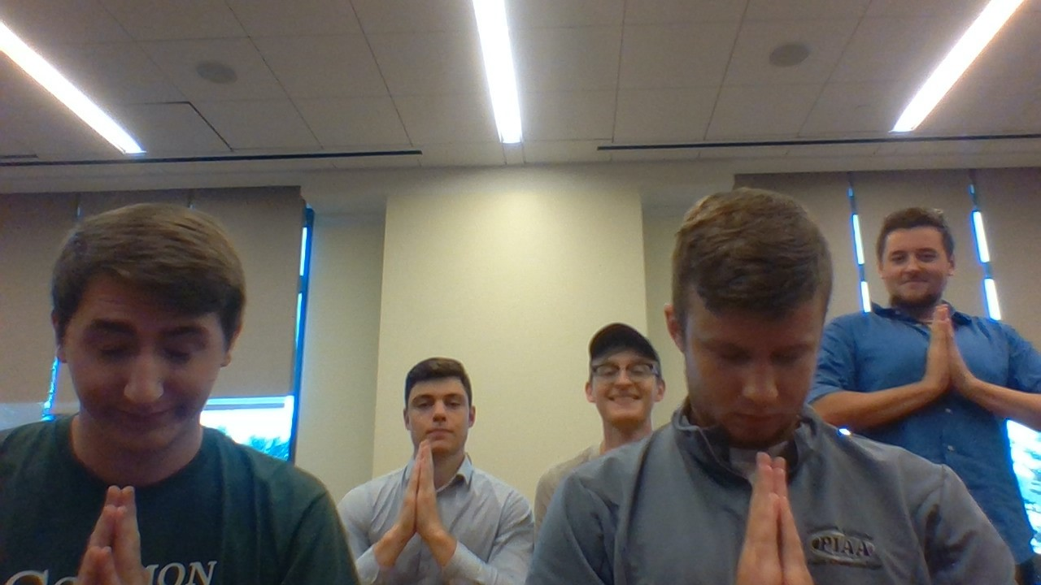
Team Picture

Slide 5
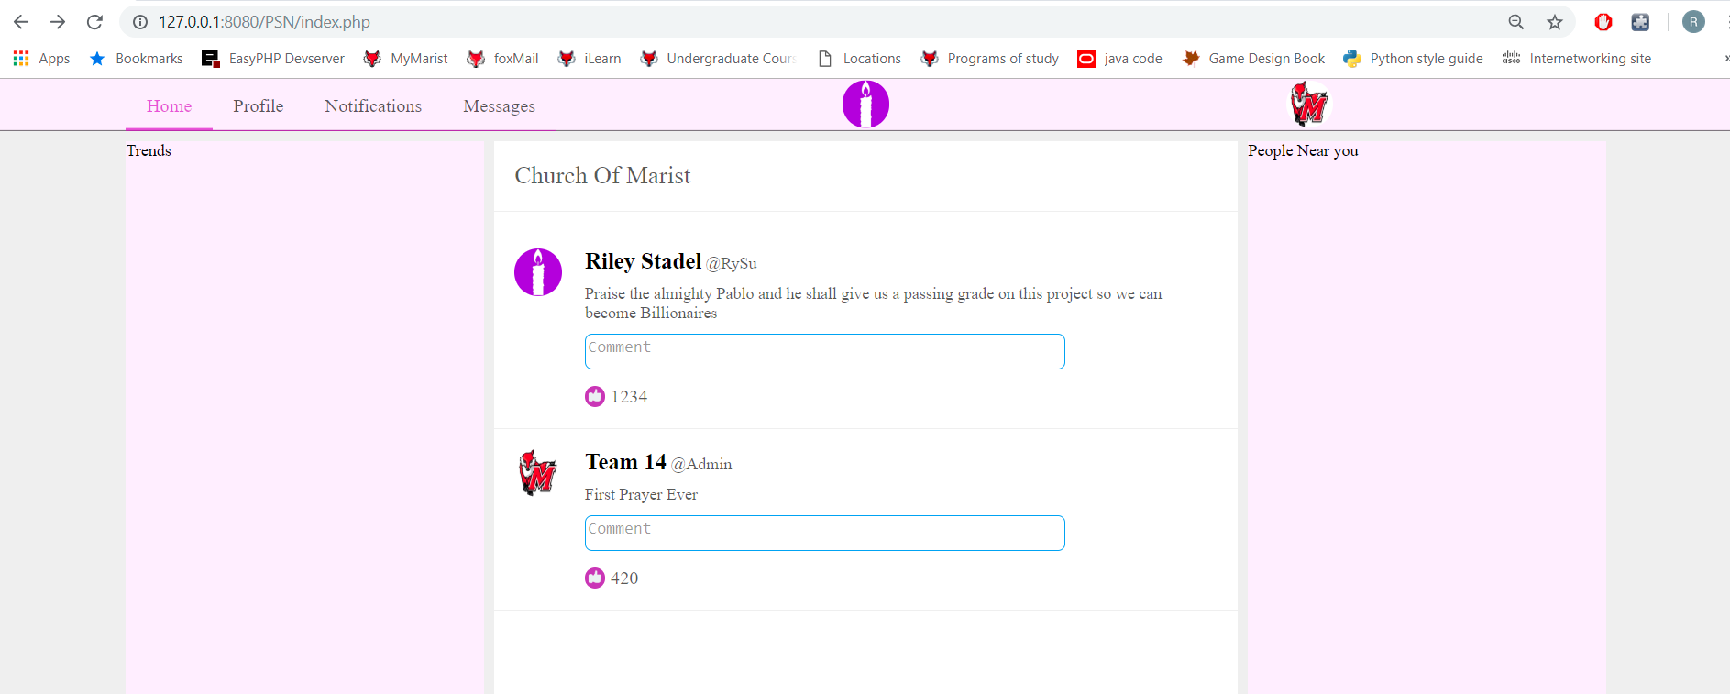
Update - Last Week

Slide 6
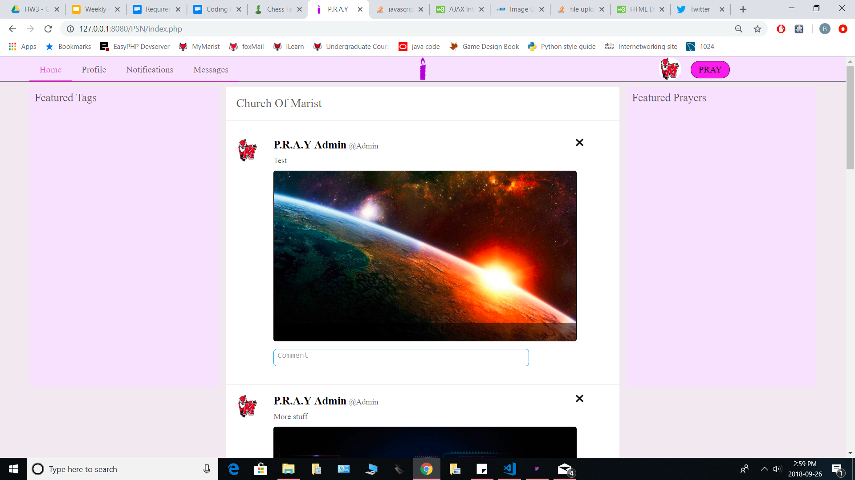
Update - This Week

Slide 7
Demo
Demo link

